Slide 1

Phonebook Management System
Data Structures using C lab
Project Based Learning.
Computer Science and Information Technology | 2023
Link: https://github.com/rsri-code/Phonebook-Management-System

Slide 2

About
The Phonebook app has basic features for adding, searching, updating and removing new contacts.
Functions like file management and data structure are all used. This application describes how to add, view, alter, recieve and delete data from and to filles.

Slide 3
Team Members
Rudransh Srivastava
Utsah Shanker
Vansh Sharma
2100290110135
2100290110178
2100290110185

Slide 4
Importance of Phonebook Management System
07/15
You will always have access to your contacts, whether you are at work or at home. The basic goal of phonebook application is to locate a person's or organization's address in a short amount of time.
For example, we can look up a person using their name, address,email,phone number or location

Slide 5


Themes
Details
Beneficiaries
Acivities
Phonebook project creates an external file to permaanently store the user's data and conduct file handling activities.
This will help you understand the core concepts of capacity, record keeping and data structure.
This system can be used by the schools, bus company, government agencies, office and company that can monitor daily activities.
This program will show you how to add, list,edit or alter, lookat and delete data from record.

Slide 6
Major Functionality
Main menu
Add new phonebook
List of Phonebook
Modify Record
Search Phonebook Record
Delete Record

Slide 7
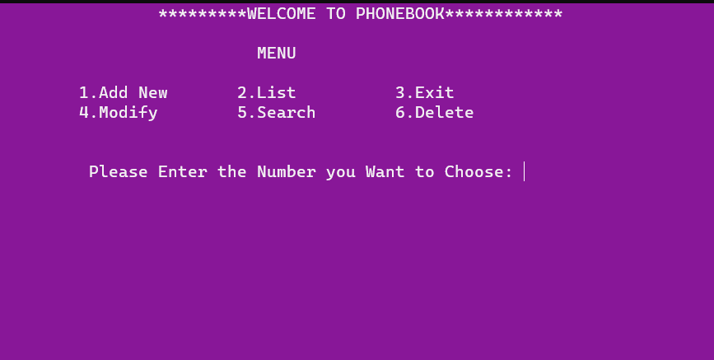
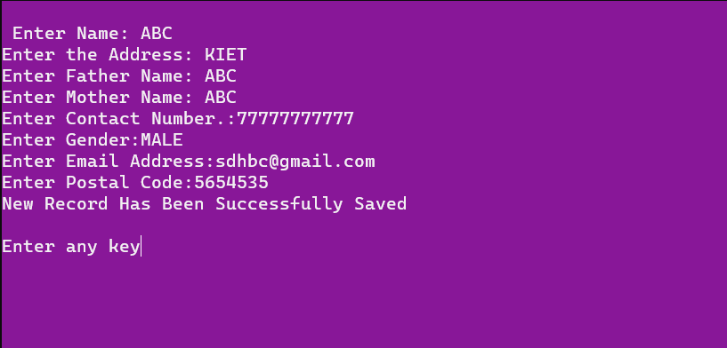
OUTPUT:-

Slide 8
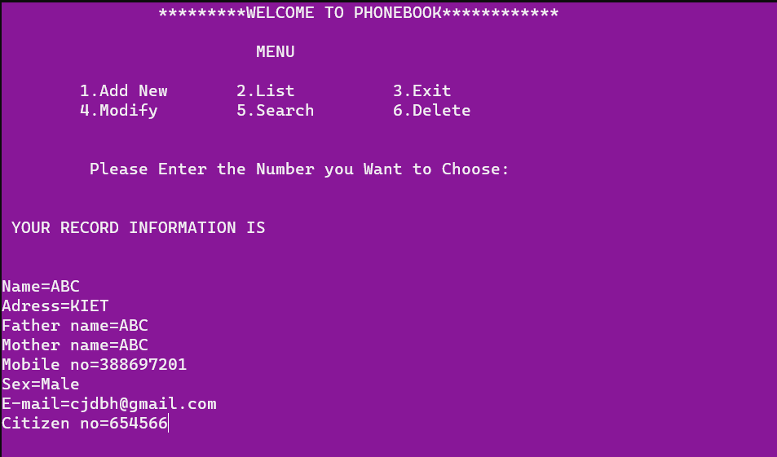
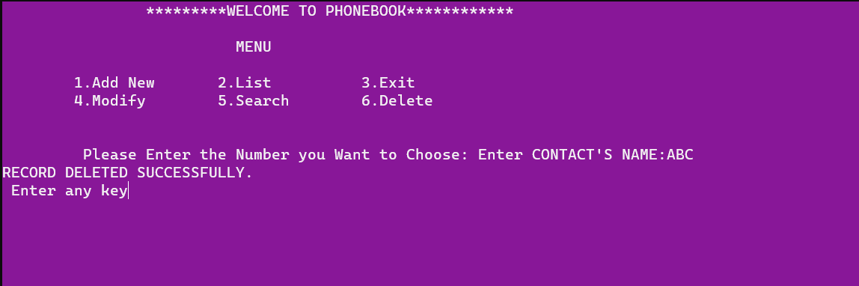
OUTPUT:-

Slide 9

Conclusion
This Phonebook Management System Project in "C" is a project created using the knowledge of various data structures like linked lists and arrays.
The whole project is designed using different variables and strings have been used for the development of this project.
Its goal is to provide students with a solid foundation in programming projects by providing useful and practical information about C and Data Structures.

Slide 10


